Slide 1
Air Law

Slide 2
Chicago Convention
The Convention on International Civil Aviation, also known as the Chicago Convention, established the International Civil Aviation Organization (ICAO).
The Convention establishes rules of airspace, aircraft registration and safety, and details the rights of the signatories in relation to air travel.
The document was signed on December 7, 1944 and has since been revised 8 times. Last in 2006.

Slide 3
Some of the Main Articles of the Convention...
Article 1: Every state has complete and exclusive sovereignty over airspace above its territory.
Article 3: Every State must refrain from resorting to the use of weapons against civil aircraft in flight.
Article 5: The aircraft of states, other than scheduled international air services, have the right to make flights across state's territories and to make stops without obtaining prior permission. However, the state may require the aircraft to make a landing.

Slide 4
Some of the Main Articles of the Convention...
Article 6: (Scheduled air services) No scheduled international air service may be operated over or into the territory of a contracting State, except with the special permission or other authorization of that State.
Article 10: (Landing at customs airports): The state can require that landing to be at a designated customs airport and similarly departure from the territory can be required to be from a designated customs airport.

Slide 5
Some of the Main Articles of the Convention...
Article 12: Each state shall keep its own rules of the air as uniform as possible with those established under the convention, the duty to ensure compliance with these rules rests with the contracting state.
Article 13: (Entry and Clearance Regulations) A state's laws and regulations regarding the admission and departure of passengers, crew or cargo from aircraft shall be complied with on arrival, upon departure and whilst within the territory of that state.

Slide 6
Some of the Main Articles of the Convention...
Article 16: The authorities of each state shall have the right to search the aircraft of other states on landing or departure, without unreasonable delay...
Article 24: Aircraft flying to, from or across, the territory of a state shall be admitted temporarily free of duty. Fuel, Oil, spare parts, regular equipment and aircraft stores retained on board are also exempt custom duty, inspection fees or similar charges.

Slide 7
Some of the Main Articles of the Convention...
Article 29: Before an international flight, the pilot in command must ensure that the aircraft is airworthy, duly registered and that the relevant certificates are on board the aircraft. The required documents are:
Certificate of Registration
Certificate of Airworthiness
Crew licences
Radio Licence
Cargo manifest
Journey Logbook
Passenger names, place of boarding and destination

Slide 8
Some of the Main Articles of the Convention...
Article 30: The aircraft of a state flying in or over the territory of another state shall only carry radios licensed and used in accordance with the regulations of the state in which the aircraft is registered. The radios may only be used by members of the flight crew suitably licensed by the state in which the aircraft is registered.
Article 32: the pilot and crew of every aircraft engaged in international aviation must have certificates of competency and licences issued or validated by the state in which the aircraft is registered.

Slide 9
Some of the Main Articles of the Convention...
Article 33: (Recognition of Certificates and Licences) Certificates of Airworthiness, certificates of competency and licences issued or validated by the state in which the aircraft is registered, shall be recognised as valid by other states. The requirements for issue of those Certificates or Airworthiness, certificates of competency or licences must be equal to or above the minimum standards established by the Convention.

Slide 10
Some of the Main Articles of the Convention...
Article 40: No aircraft or personnel with endorsed licenses or certificate will engage in international navigation except with the permission of the state or states whose territory is entered. Any license holder who does not satisfy international standard relating to that license or certificate shall have attached to or endorsed on that license information regarding the particulars in which he does not satisfy those standards.

Slide 11
SUMMARY
Freedom | Description
1st. | Right to overfly a foreign country without landing
2nd. | Right to refuel or carry out maintenance in a foreign country
3rd. | Right to fly from one's own country to another
4th. | Right to fly from a foreign country to one's own
5th. | Right to fly between two foreign countries during flights which begin or end in one's own
6th. | Right to fly from one foreign country to another one while stopping in one's own country
7th. | Right to fly between two foreign countries while not offering flights to one's own country
8th. | Right to fly between two or more airports in a foreign country while continuing service to one's own country
9th. | Right to fly inside a foreign country without continuing service to one's own country
Only the first two of these freedoms apply automatically to signatory states, the remainder being subject to national agreement.

Slide 12
Airfield Signs
Mandatory signs. These red signs are designed to stand out above all others. They denote runway entrances, critical areas, or areas where entrance by aircraft is prohibited. The sign identifying a runway typically has a number only, as in 28 for Runway 28, and is found at the end of the taxiway leading directly to the beginning of the takeoff end of the runway.
Direction signs. These are easy to identify because they always include one or more arrows. These are especially helpful at large airports with many taxiways and are usually seen in conjunction with taxiway location signs. The signs with yellow lettering on a black background tell you which taxiway you are on. The signs with black lettering and arrows tell you that you are approaching the intersection between the taxiway you are currently on and another taxiway. The arrows indicate the direction in which you must turn in order to access the identified taxiway when you reach the upcoming intersection. Black on Yellow.
Location signs. These simply identify either the taxiway or runway on which the aircraft is located. Sometimes these signs are used in conjunction with red runway holding position signs, or they may be positioned to help pilots determine which runway they are on, especially where runways converge. Yellow on Black

Slide 13
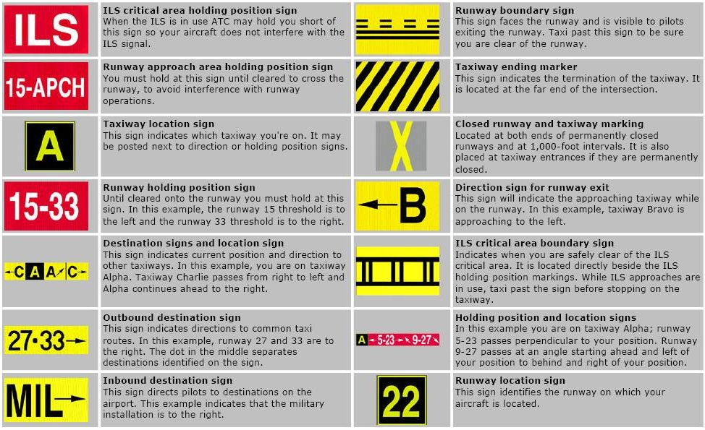

Slide 14
Areas of the Airport
A manoeuvring area or manoeuvring area is that part of an aerodrome to be used by aircraft for takeoff, landing, and taxiing, excluding aprons and areas designed for maintenance of an aircraft
The airport apron is the area of an airport where aircraft are parked, unloaded or loaded, refuelled, or boarded.

Slide 15
Airport Lighting
The most basic component of Airport Lighting is the white runway edge lights.
Runway end lighting. As you approach the runway from the air, these lights appear green to indicate the beginning of the runway. If you face the opposite direction on the runway, these lights appear red, to mark the end of the runway.
Blue Edge Lights are used to border taxiways and ramp areas.
Taxiway centreline lights are green.

Slide 16
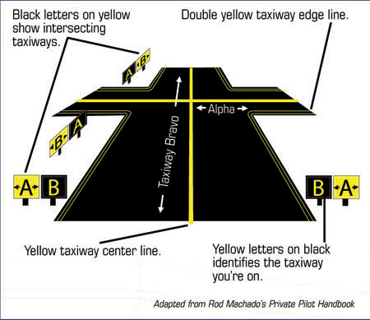

Slide 17
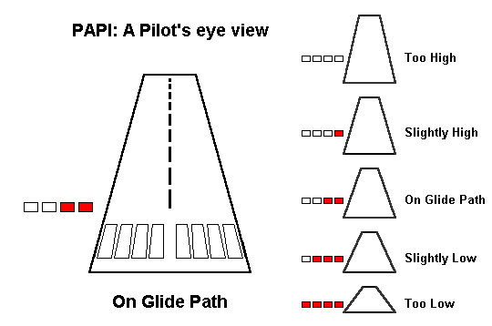

Slide 18
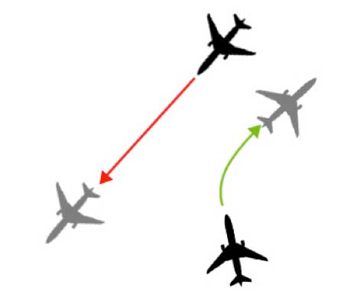
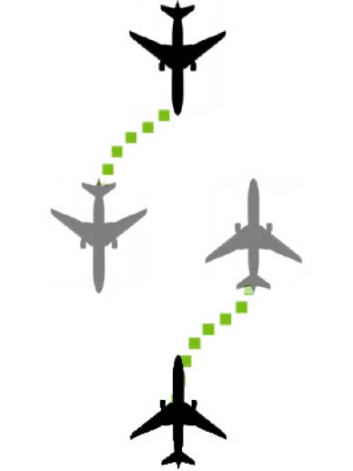
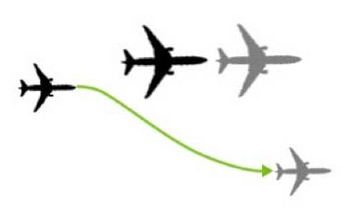
Aircraft Rights of Way.

Slide 19
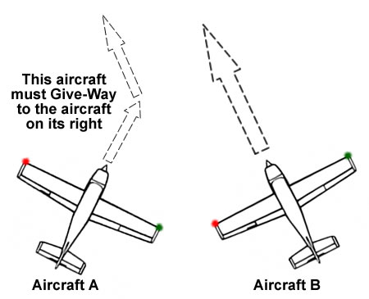

Slide 20
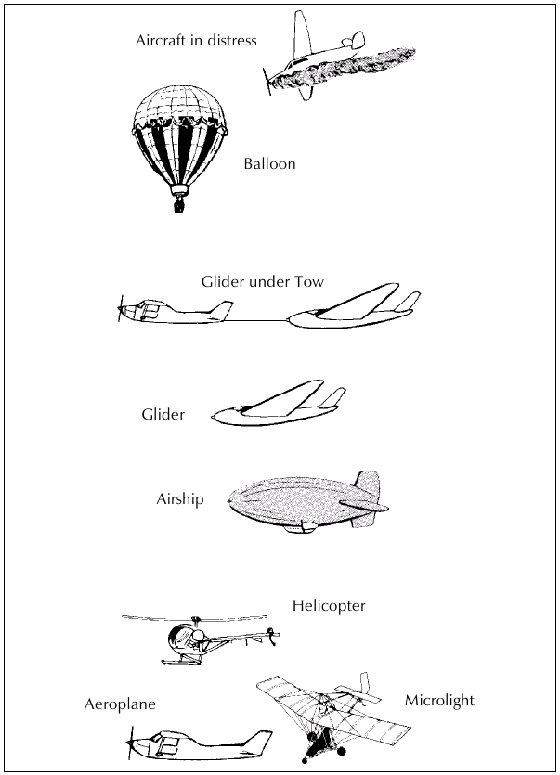

Slide 21
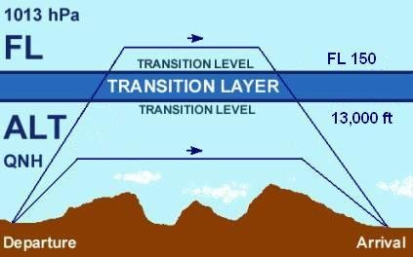

Slide 22
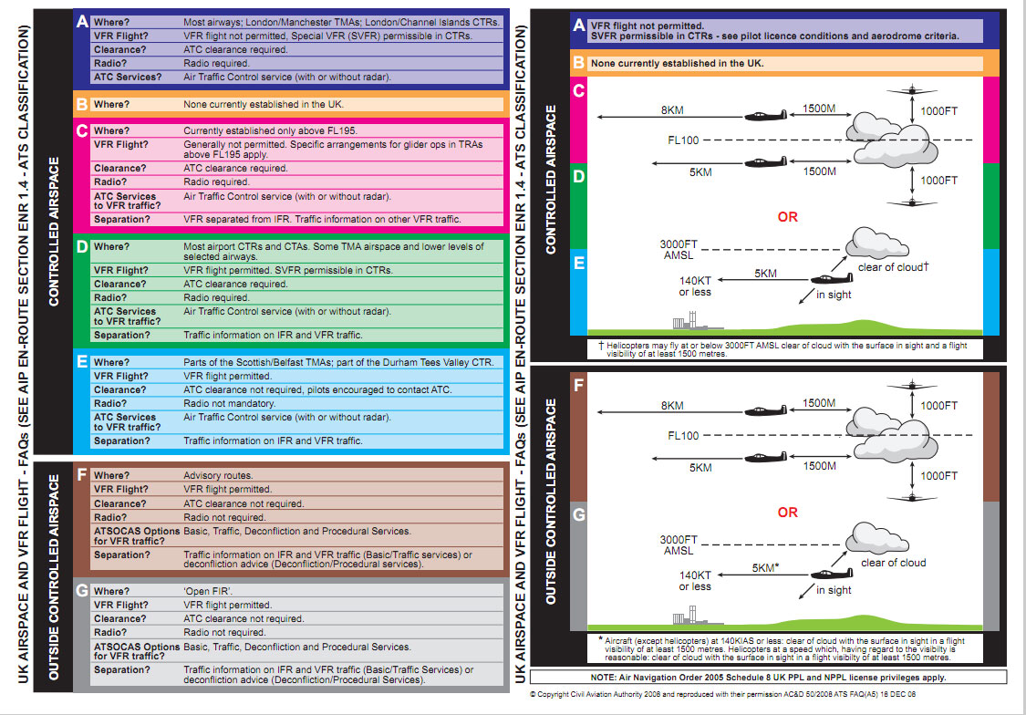

Slide 23
Emergency Squawks
One of the biggest problems in emergencies is the pilots failure to properly communicate the emergency. Knowing the emergency transponder squawk codes can help ATC evaluate your situation and notify help sooner or aid in getting you to the nearest airport.
Below are the 3 squawk codes every pilot should commit to memory:
7500 – Hijack 7600 – Lost Communication (radio failure) 7700 – Emergency
An easy way to remember this:
75 taken alive, 76 technical glitch, 77 going to heaven.

Slide 24
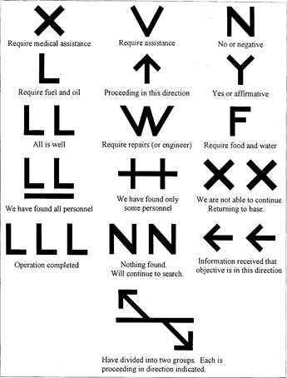
Ground Search and Rescue Signals

Slide 25
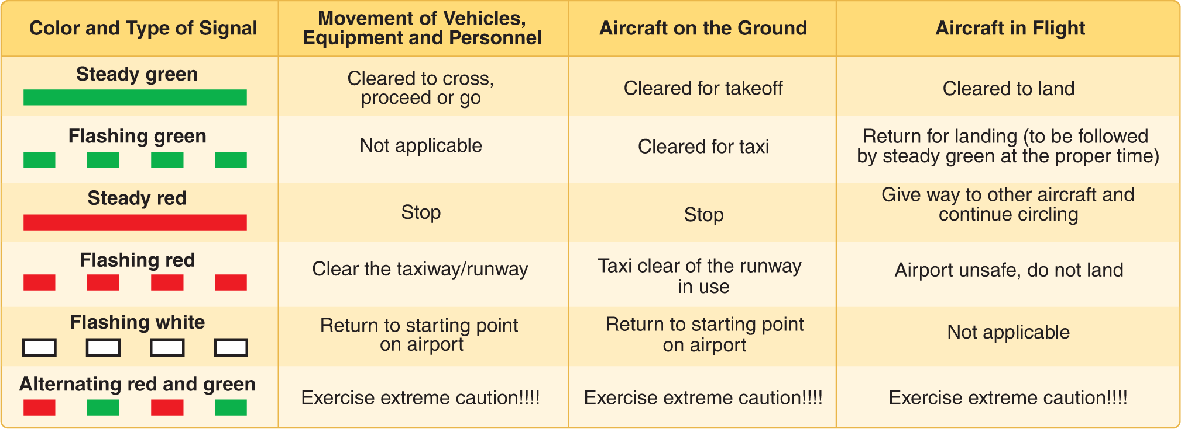

Slide 26
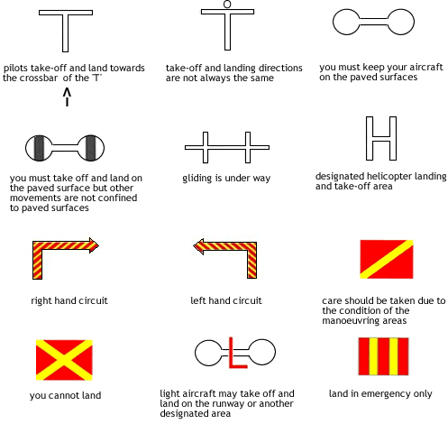

Slide 27
“Accident” means an occurrence associated with the operation of an aircraft which, in the case of a manned aircraft, takes place between the time any person boards the aircraft with the intention of flight and such time as all such persons have disembarked, or in the case of an unmanned aircraft, takes place between the time the aircraft is ready to move with the purpose of flight until such time it comes to rest at the end of the flight and the primary propulsion system is shut down, in which:

Slide 28
a person is fatally or seriously injured as a result of:
being in the aircraft
direct contact with any part of the aircraft, including parts which have become detached from the aircraft
direct exposure to jet blast, except when the injuries are from natural causes, self-inflicted or inflicted by other persons, or when the injuries are to stowaways hiding outside the areas normally available to the passengers and crew
the aircraft sustains damage or structural failure which adversely affects the structural strength, performance or flight characteristics of the aircraft, and would normally require major repair or replacement of the affected component, except for engine failure or damage, when the damage is limited to a single engine, (including its cowlings or accessories), to propellers, wing tips, antennas, probes, vanes, tires, brakes, wheels, fairings, panels, landing gear doors, windscreens, the aircraft skin (such as small dents or puncture holes) or minor damages to main rotor blades, tail rotor blades, landing gear, and those resulting from hail or bird strike.
the aircraft is missing or is completely inaccessible.

Slide 29
Definition of serious injury
“Serious injury” means an injury which is sustained by a person in an accident and which involves one of the following:
hospitalisation for more than 48 hours, commencing within 7 days from the date the injury was received;
a fracture of any bone (except simple fractures of fingers, toes, or nose);
lacerations which cause haemorrhage, nerve, muscle or tendon damage;
injury to any internal organ;
second or third degree burns, or any burns affecting more than 5% of the body surface;
verified exposure to infectious substances or harmful radiation.

Slide 30
“Serious Incident” means an incident involving circumstances indicating that there was a high probability of an accident and is associated with the operation of an aircraft, which in the case of a manned aircraft, takes place between the time any person boards the aircraft with the intention of flight until such time as all such persons have disembarked, or in the case of an unmanned aircraft, takes place between the time the aircraft is ready to move with the purpose of flight until such time it comes to rest at the end of the flight and the primary propulsion system is shut down.
The incidents listed below are typical examples of serious incidents. The list is not exhaustive and only serves as a guide to the definition of ‘serious incident’.

Slide 31
A near collision requiring an avoidance manoeuvre or when an avoiding manoeuvre would have been appropriate to avoid a collision or an unsafe situation.
Controlled flight into terrain (CFIT) only marginally avoided.
An aborted takeoff or a takeoff using a closed or engaged runway, a taxiway or unassigned runway.
A landing or attempted landing on a closed or engaged runway, a taxiway or unassigned runway.
Gross failure to achieve predicted performance during takeoff or initial climb.
All fires and/or smoke in the cockpit, in the passenger compartment, in cargo compartments or engine fires, even though such fires were extinguished with extinguishing agents.
Any events which require the emergency use of oxygen by the flight crew.
Aircraft structural failure or engine disintegration, including uncontained turbine engine failure, which is not classified as an accident.
Multiple malfunctions of one or more aircraft systems that seriously affect the operation of the aircraft.
Any case of flight crew incapacitation in flight.
Any fuel state which would require the declaration of an emergency by the pilot.
Runway incursions classified with severity A. The ‘Manual on the Prevention of Runway Incursions’ (Doc 9870) contains information on the severity classifications.
Takeoff or landing incidents, such as undershooting, overrunning or running off the side of runways.
System failures, weather phenomena, operation outside the approved flight envelope or other occurrences which caused or could have caused difficulties controlling the aircraft.
Failure of more than one system in a redundancy system which is mandatory for flight guidance and navigation.
The unintentional or, as an emergency measure, the intentional release of a slung load or any other load carried external to the aircraft.

Slide 32
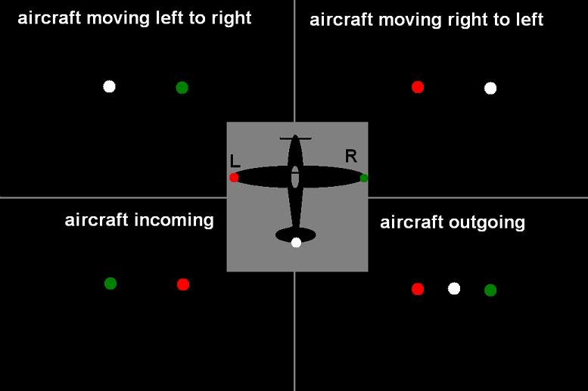
Night Flying
Official Night is the period between - 30 Minutes after Sunset until 30 Minutes before Sunrise.

Slide 33
Medical
For Medical Certificate Validity Period – see back of Medical Certificate.
Should you become aware of a decrease in your Medical Fitness you should seek the advice of the Authority or a Medical Examiner.
https://www.caa.co.uk/WorkArea/DownloadAsset.aspx?id=4294973639

Slide 34
UK Aeronautical Information Publication (AIP)
Static information, updated every 28 days, containing information of lasting (permanent) character essential to air navigation.
UK AIP Supplements (SUPs) Temporary changes to the AIP, usually of long duration, containing comprehensive text and/or graphics.
Aeronautical Information Circulars (AICs) Notices relating to safety, navigation, technical, administrative or legal matters.
NOTAM Notices concerning the condition or change to any facility, service or procedure notified within the AIP. NOTAM are available in the form of Pre-Flight Information Bulletins (PIB) using a live database.
AIS Information Line on tel: 0500 354802 or +44(0)20 8750 3939 This service is offered by AIS to supplement the information available from the Website. A recorded message allows you to obtain up to date information on specific NOTAM, and will include Restricted Areas (Temporary), Airspace Upgrades & Emergency Restrictions of Flying.
VFR Chart Newsletter & Update Service Full list of amendments to current charts, email/RSS notification service and other information relating to VFR charting.
UK Foreign IAIP Library Access to foreign aeronautical information, available to interested parties for flight planning purposes.

Slide 35
NOTAM
Q) EGTT/QWGXX/IV/M/W/000/031/5345N00105W005
B) FROM: 16/04/06 07:09C) TO: PERM
E) AMEND BURN GLIDER SITE, SELBY, YORKSHIRE, 534445N 0010504W, UPPER
LIMIT TO 3000FT AGL.
UK AIP ENR 5.5 REFERS
LOWER: SFC
UPPER: 3020FT AMSL

